Slide 1


ERCC9 Data Analysis Tutorial
created by the Data Management and Resource Repository (DMRR)
Use Case 1: Exogenous exRNA in plasma
of patients with Colorectal Cancer
and Ulcerative Colitis
updated March 2018
Data kindly provided by David Galas,
Pacific Northwest Research Institute (PNRI)

Slide 2
Use Case 1: Exogenous exRNA
The goal of this tutorial is to demonstrate how to
Access the exRNA Atlas
Select a group of datasets
Examine pre-computed results from the exceRpt small RNA-seq analysis pipeline to answer biological questions of interest.
Wang K., Hong L., Yuan Y., Etheridge A., Zhou Y., Huang D., Wilmes P., & Galas D. (2012) The Complex Exogenous RNA Spectra in Human Plasma: An Interface with Human Gut Biota? PLoS ONE 7: e51009.

Slide 3
Background: Comparison of human plasma small RNA profiles of patients with colorectal cancer to those with ulcerative colitis indicated that a large fraction of reads were not mapping to the human genome. This finding raises the question – what is the origin of those small RNAs?
Results: Mapping suggested that a significant fraction of small RNA reads were derived from bacterial, fungal, and plant sources.
Use Case 1: Exogenous exRNA
Wang K., Hong L., Yuan Y., Etheridge A., Zhou Y., Huang D., Wilmes P., & Galas D. (2012) The Complex Exogenous RNA Spectra in Human Plasma: An Interface with Human Gut Biota? PLoS ONE 7: e51009.

Slide 4
Use Case 1: Exogenous exRNA
We will use the exRNA Atlas and the pre-calculated results from the exceRpt small RNA-seq analysis pipeline there to answer the following questions:
Do all plasma small RNAs map to the human genome?
What are the sources of small RNAs found in human plasma that do not map to the human genome?
Which miRNAs are normally present in human plasma?
Wang K., Hong L., Yuan Y., Etheridge A., Zhou Y., Huang D., Wilmes P., & Galas D. (2012) The Complex Exogenous RNA Spectra in Human Plasma: An Interface with Human Gut Biota? PLoS ONE 7: e51009.

Slide 5

First, how can we find the datasets from this publication in the exRNA Atlas?
Finding datasets
at the exRNA Atlas
We need to find the dataset associated with this publication:
Wang K., Hong L., Yuan Y., Etheridge A., Zhou Y., Huang D., Wilmes P., & Galas D. (2012) The Complex Exogenous RNA Spectra in Human Plasma: An Interface with Human Gut Biota? PLoS ONE 7: e51009.

Slide 6
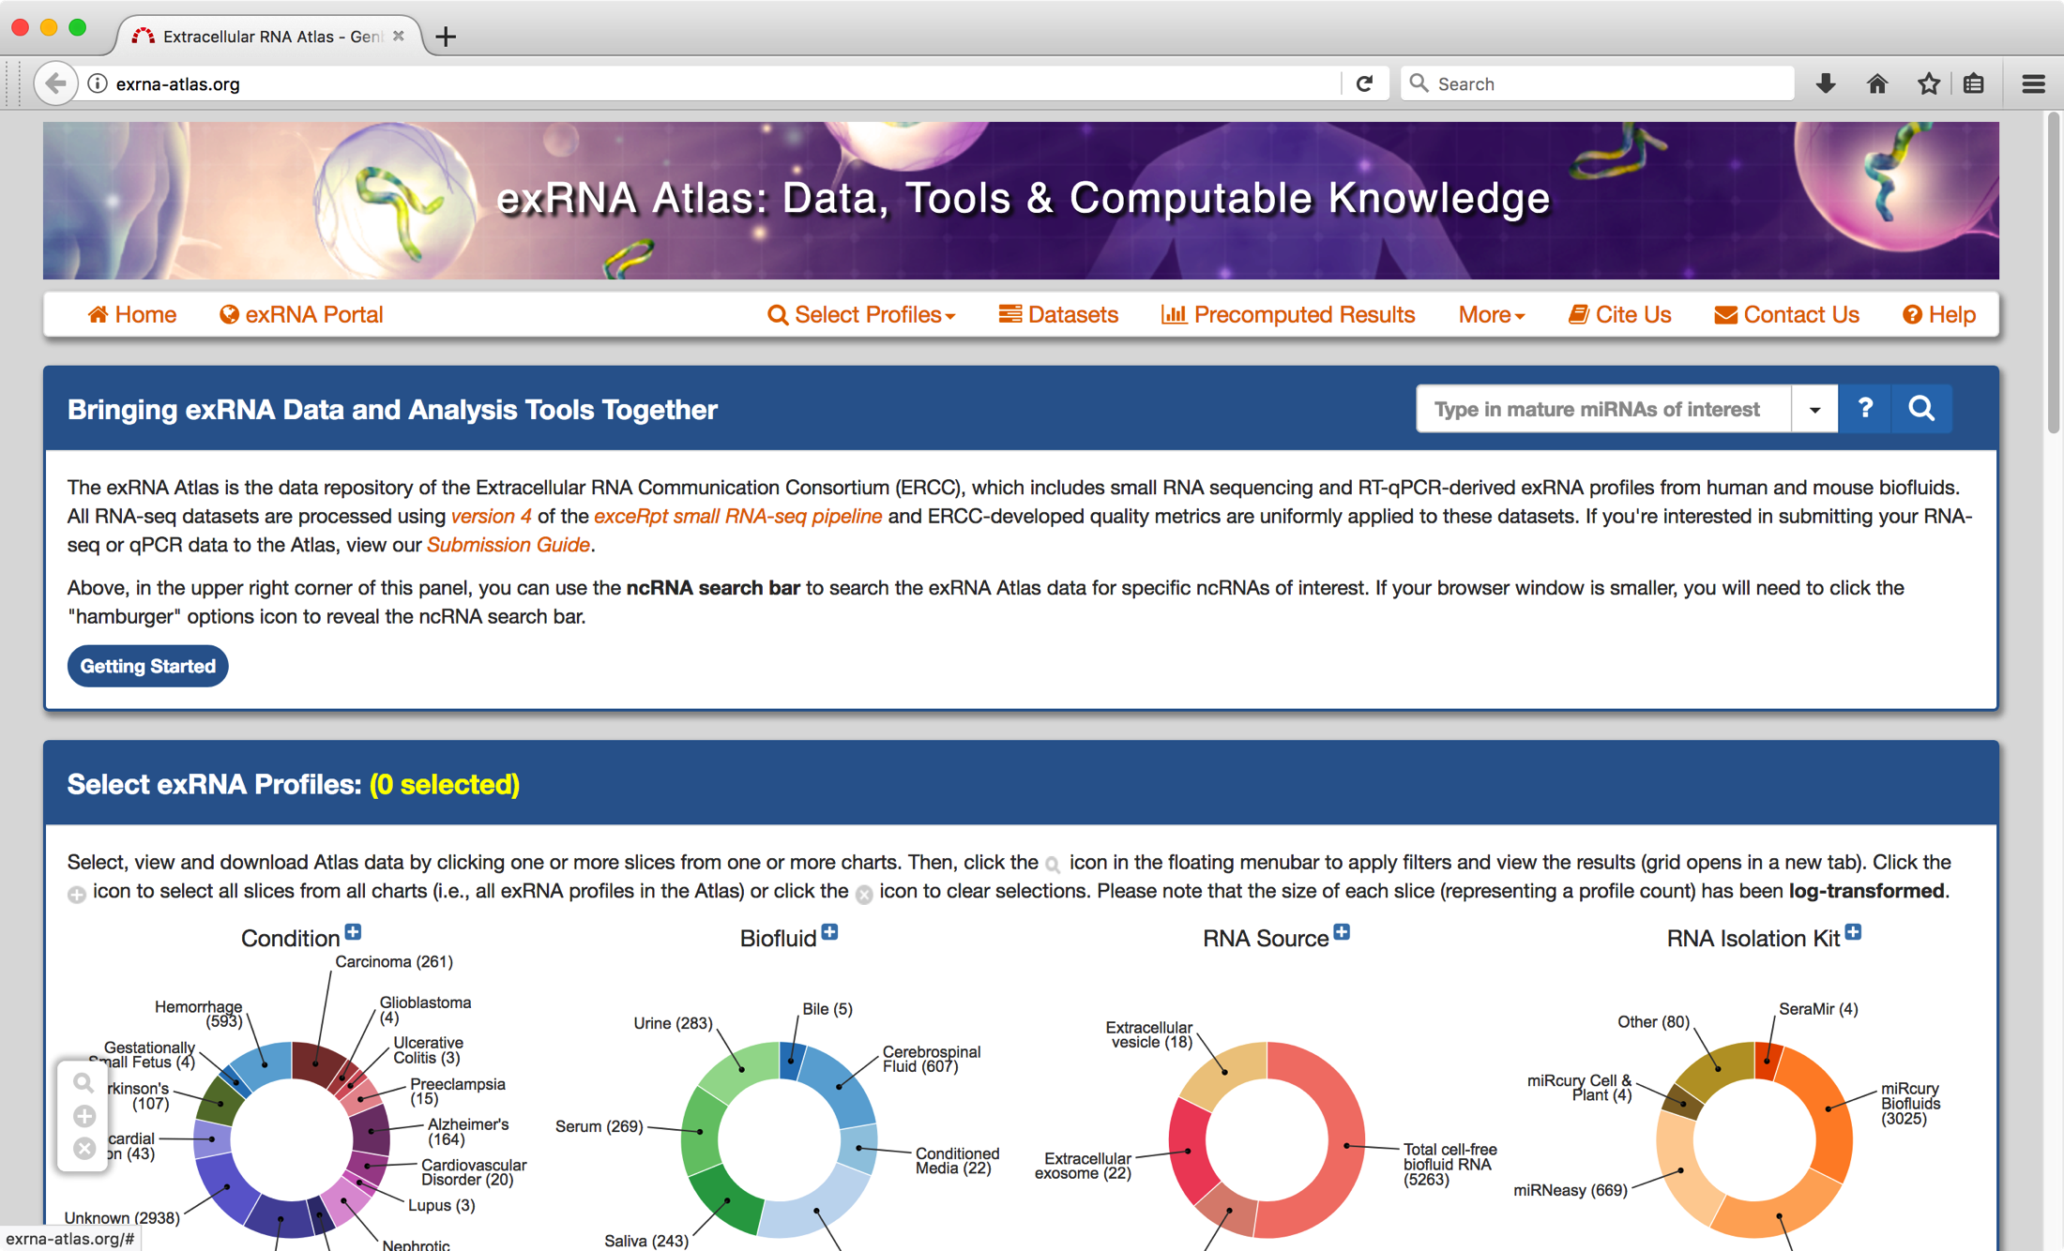
1) Go to https://exRNA-Atlas.org
Finding datasets at the exRNA Atlas

Slide 7
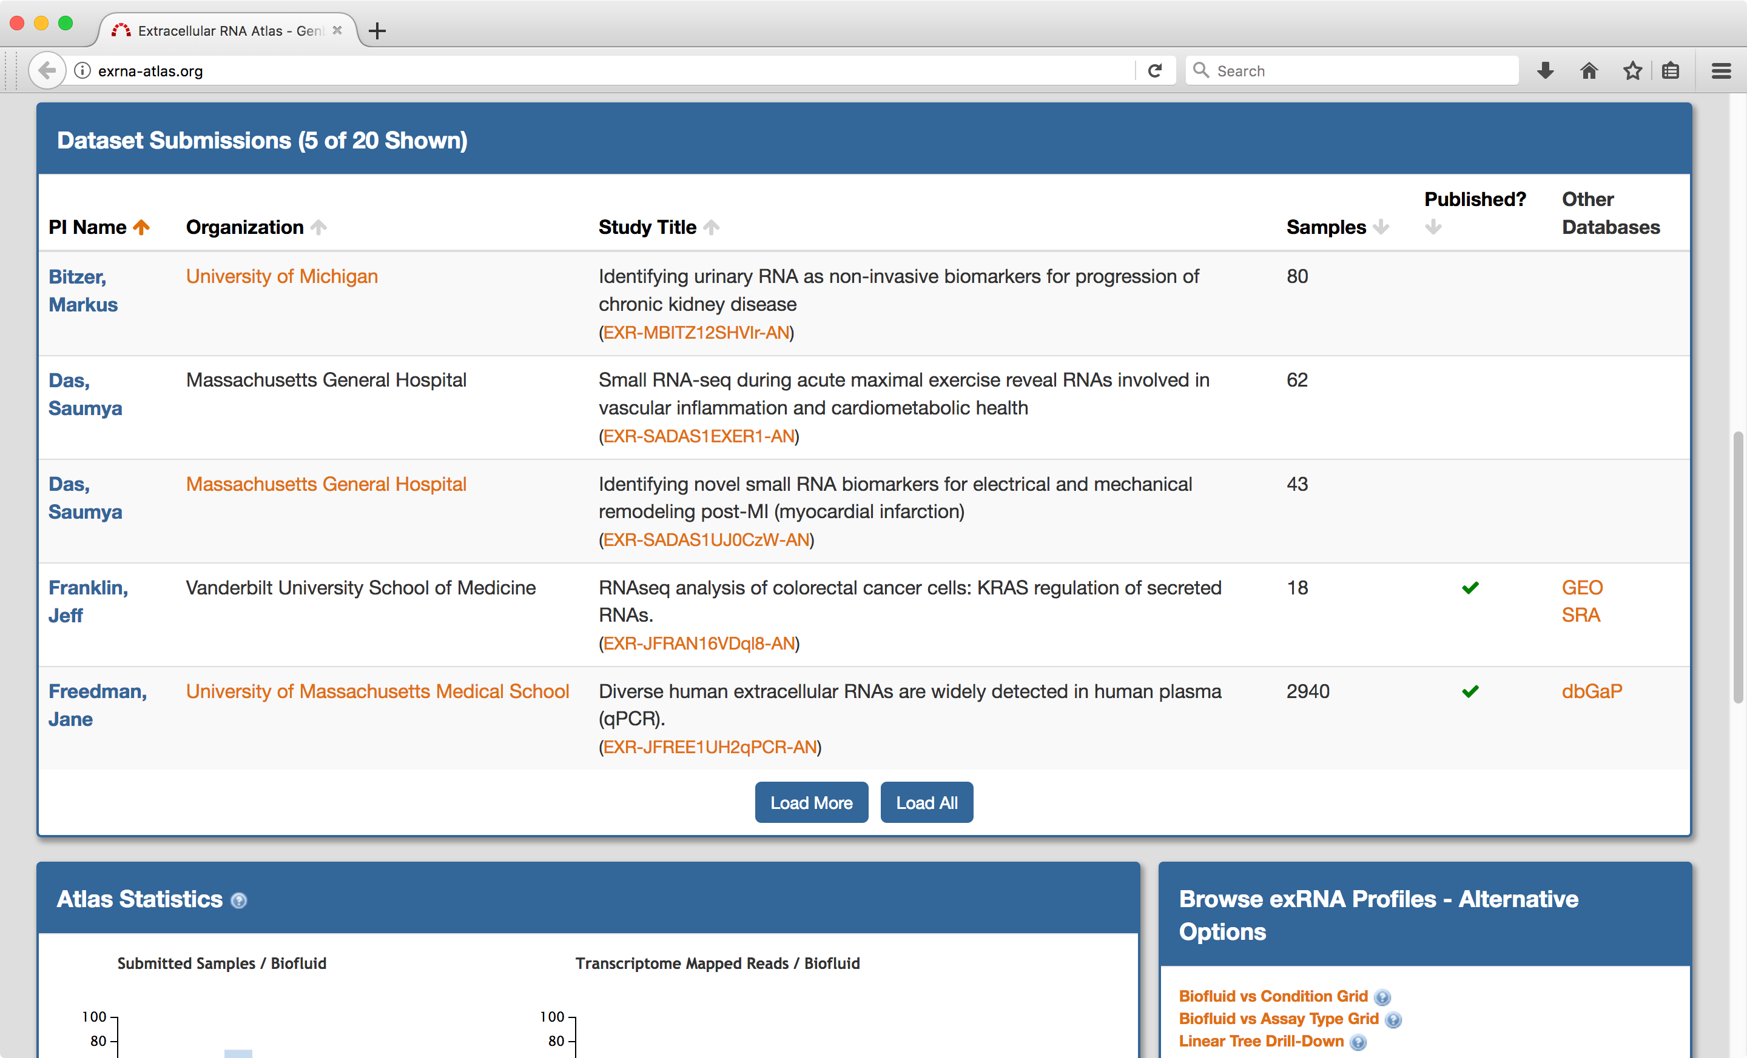

2) Scroll down to Dataset Submissions and click Load All
Finding datasets at the exRNA Atlas

Slide 8
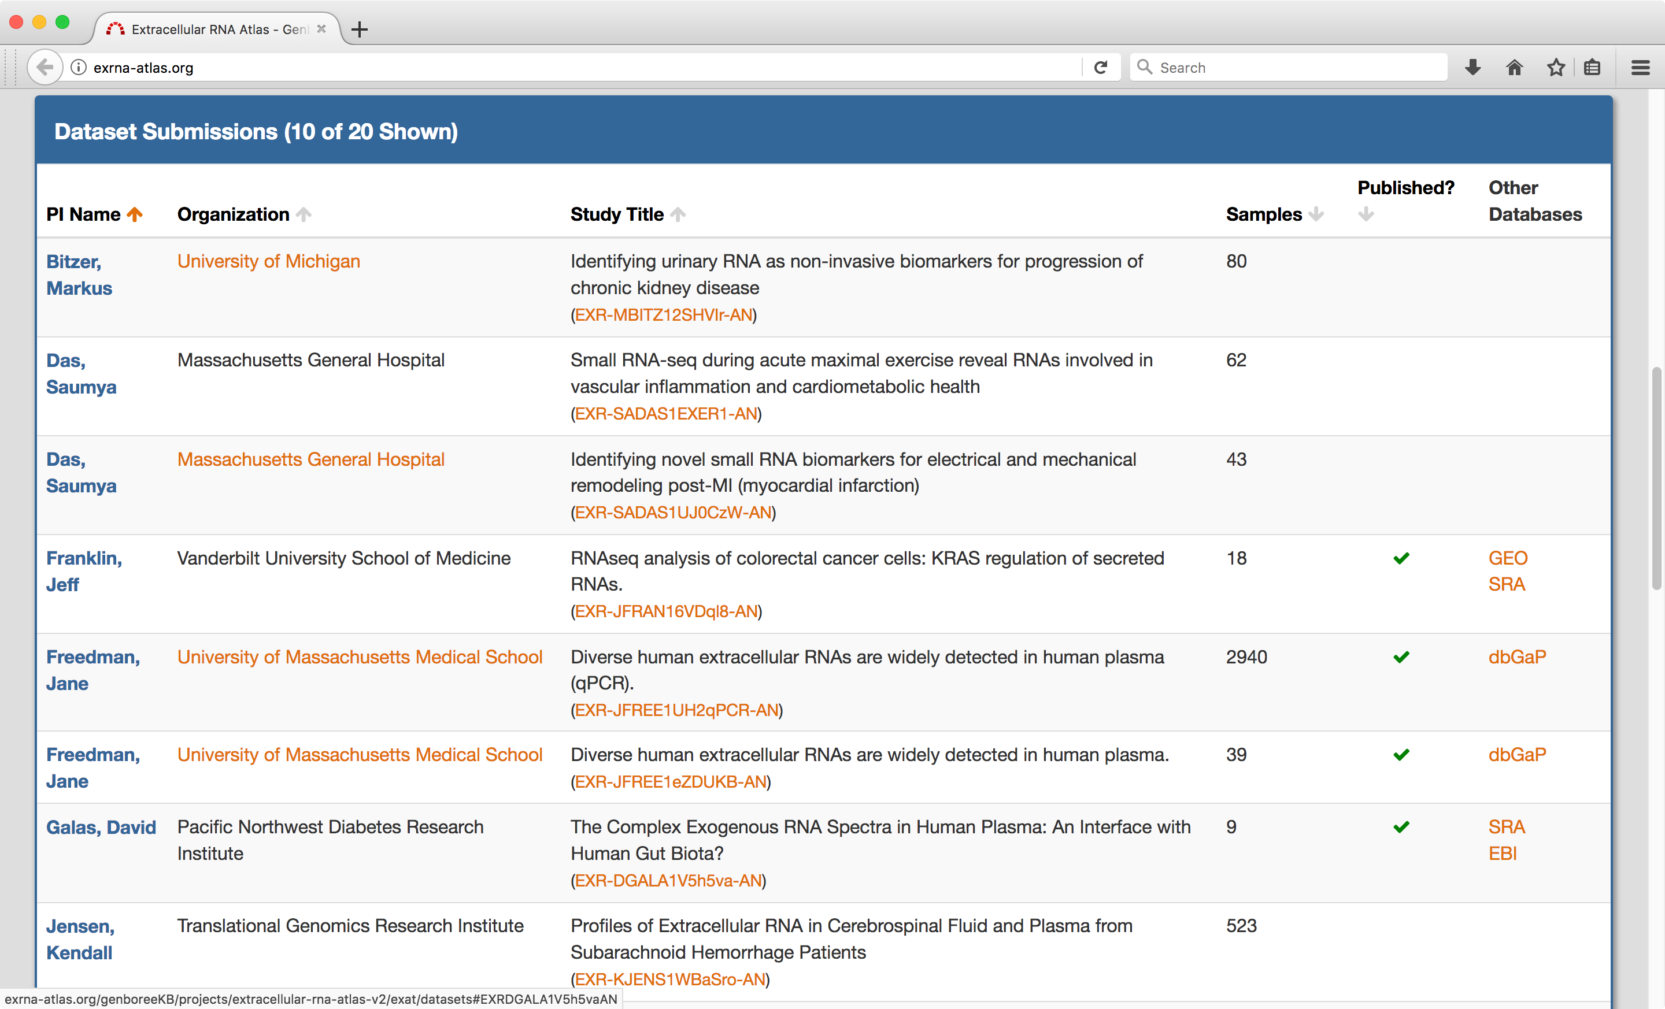
3) Click on the ID number of the appropriate dataset (EXR-DGALA1V5h5va-AN)
Finding datasets at the exRNA Atlas

Slide 9
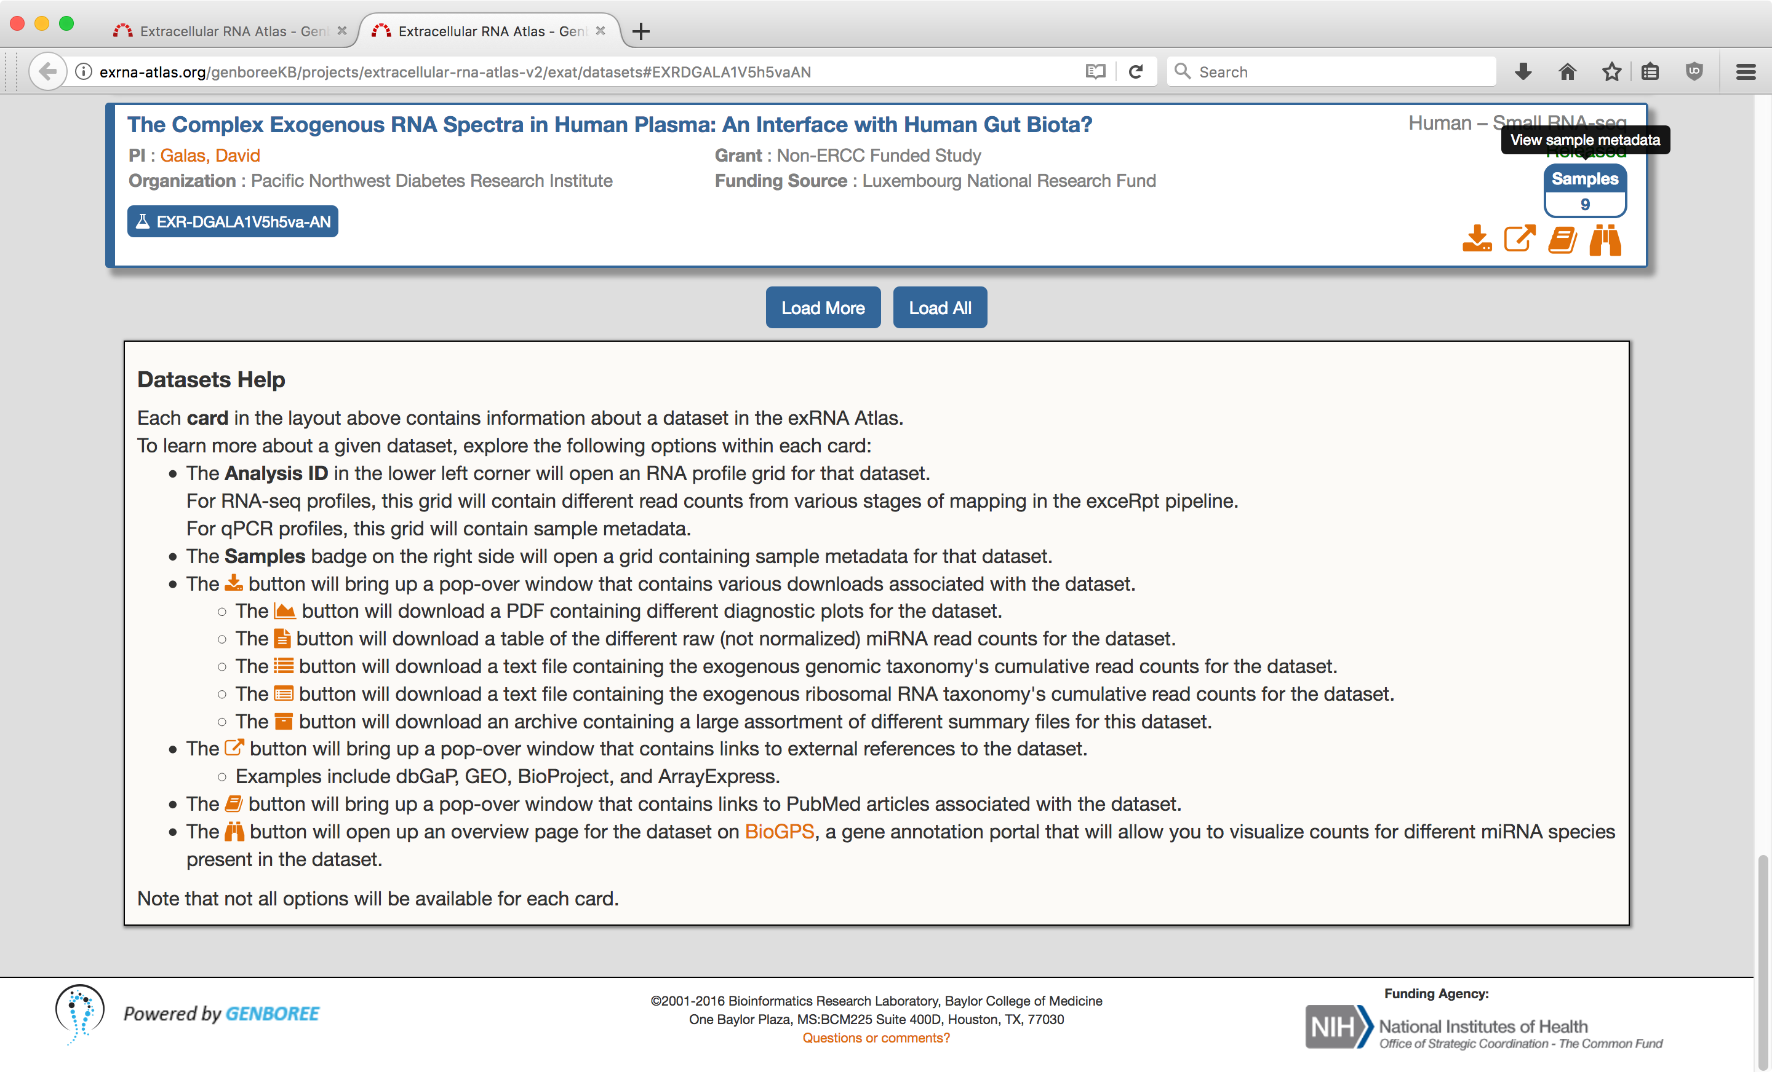
4) Click on Samples 9 to view sample metadata
Finding datasets at the exRNA Atlas

Slide 10
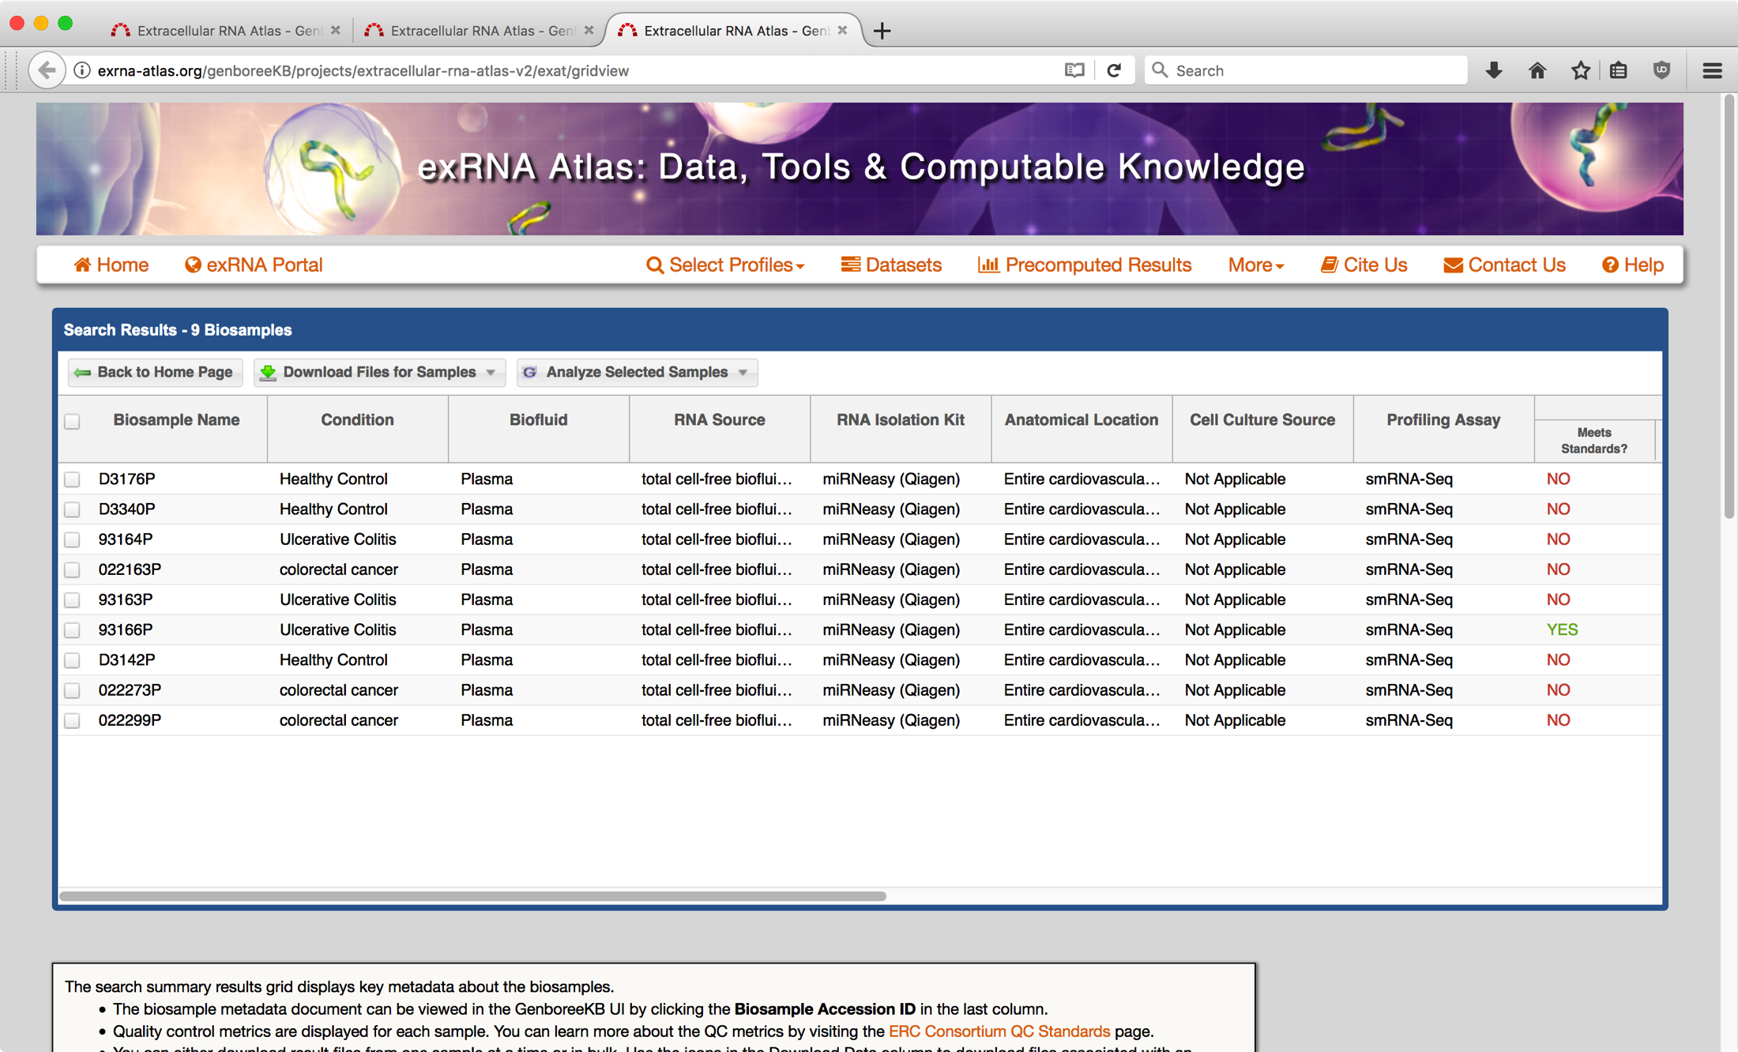
Here is the dataset (set of samples) we want to analyze.
Finding datasets at the exRNA Atlas

Slide 11
Here is the dataset (set of samples) we want to analyze.
Finding datasets at the exRNA Atlas
Do all plasma small RNAs map to the human genome?

Slide 12
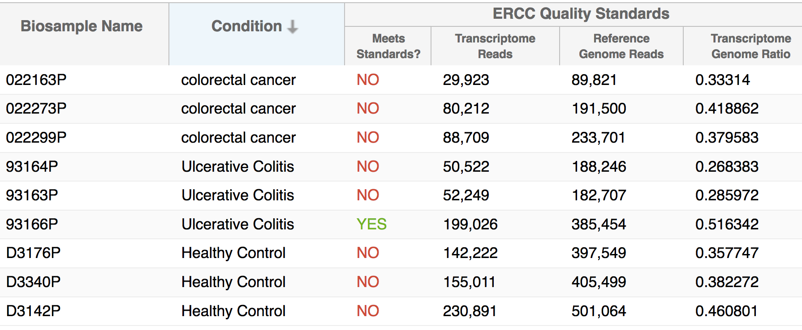
Use Case 1: Exogenous exRNA
Do all plasma small RNAs map to the human genome?
These plasma samples all have a high fraction of exogenous RNA, i.e. RNA that comes from organisms other than the human host.
ERCC quality control (QC) standards require that over half the reads in a sample map to the human genome. All but one of these samples do not meet that criterion.
NO!
Wang K., Hong L., Yuan Y., Etheridge A., Zhou Y., Huang D., Wilmes P., & Galas D. (2012) The Complex Exogenous RNA Spectra in Human Plasma: An Interface with Human Gut Biota? PLoS ONE 7: e51009.

Slide 13
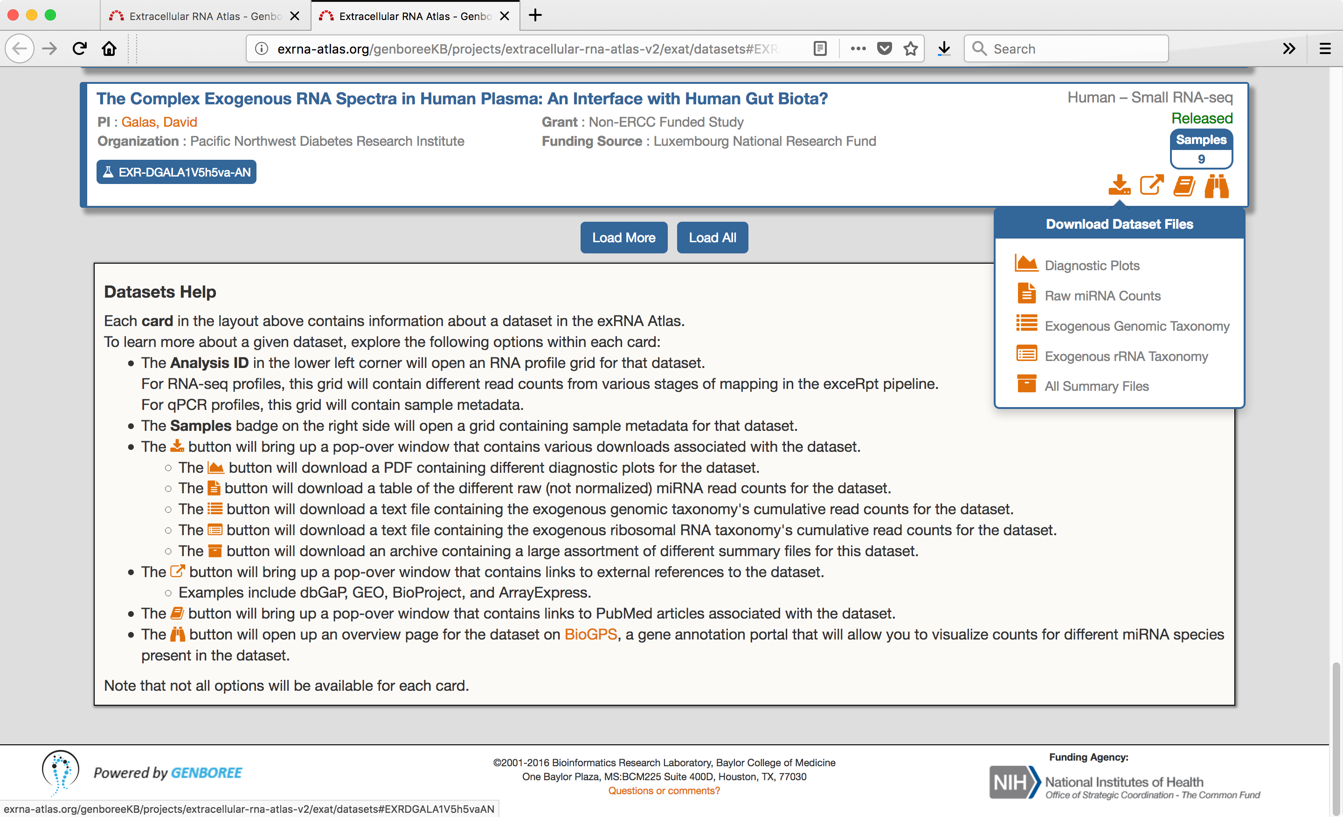
Use Case 1: Exogenous exRNA
Given that many small RNAs in these plasma samples are non-human, what is their source?
The exceRpt small RNA-seq analysis pipeline automatically maps non-human RNAs to the genomes of all sequenced bacteria, viruses, and a wide selection of eukaryotes.
You can download read counts of those mappings on the Dataset page.
Wang K., Hong L., Yuan Y., Etheridge A., Zhou Y., Huang D., Wilmes P., & Galas D. (2012) The Complex Exogenous RNA Spectra in Human Plasma: An Interface with Human Gut Biota? PLoS ONE 7: e51009.

Slide 14
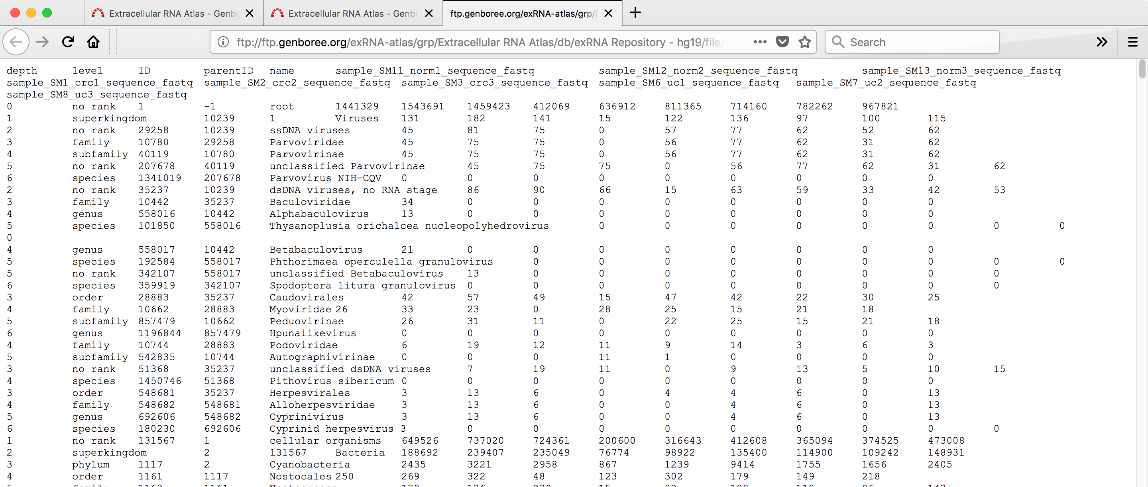
Use Case 1: Exogenous exRNA
Given that many small RNAs in these plasma samples are non-human, what is their source?
You can download read counts of those mappings on the Dataset page.
The result is a text file table in a new browser tab.

Slide 15
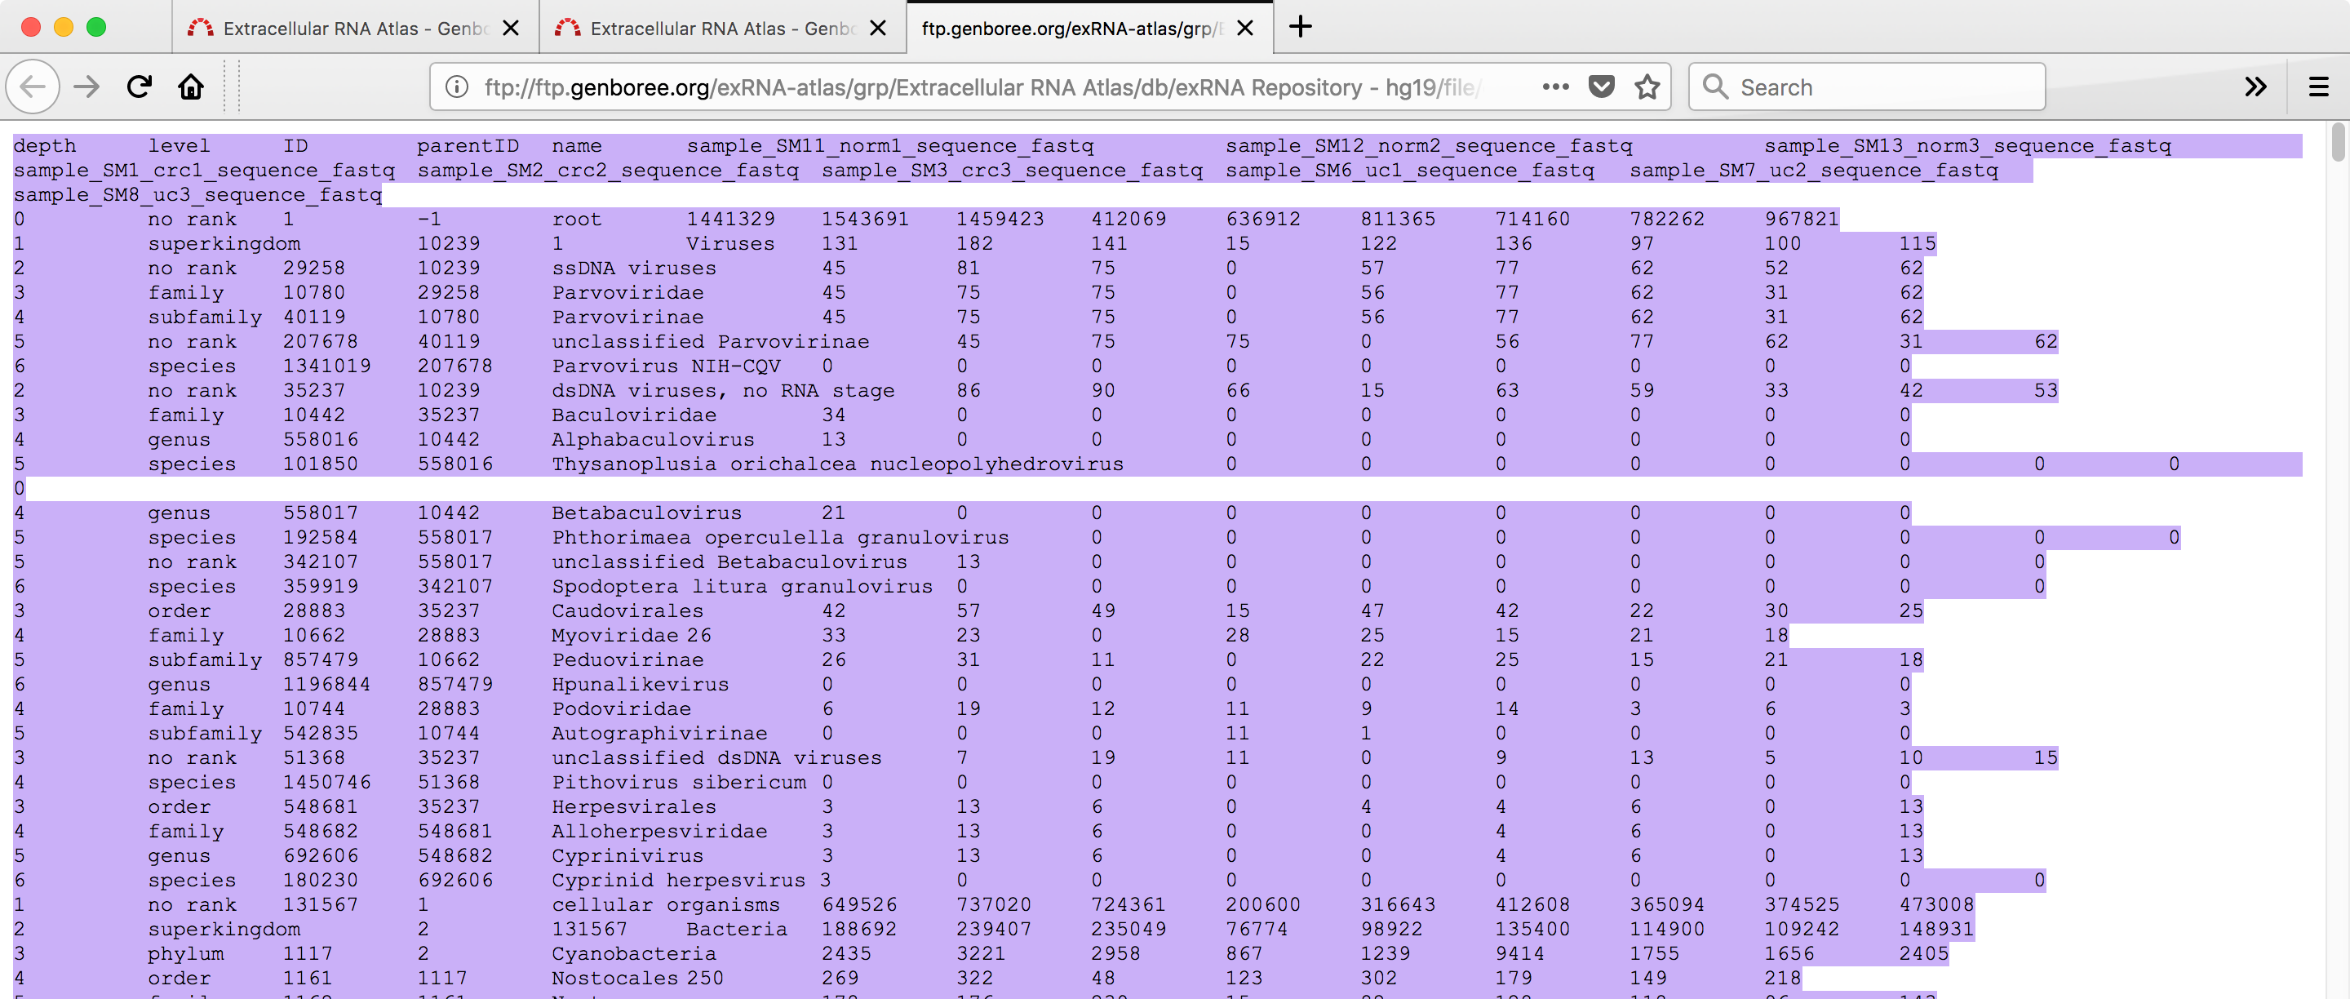
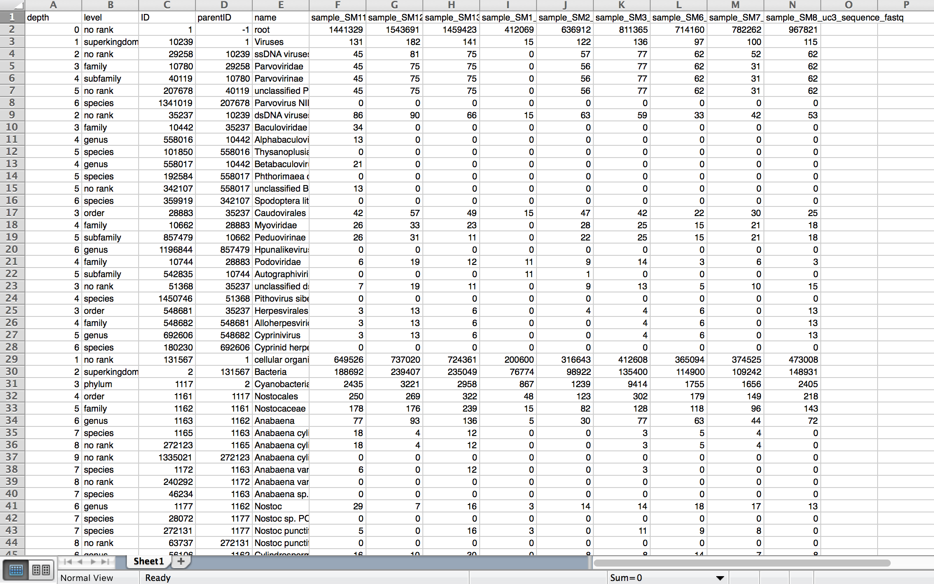
Use Case 1: Exogenous exRNA
Given that many small RNAs in these plasma samples are non-human, what is their source?
Copy and paste that read count table into Excel (Paste Special – as Text).
Then sum the read counts for all the samples and filter to show only the top levels of the tree with nodes where more than 5% of the reads map.

Slide 16
Use Case 1: Exogenous exRNA
Given that many small RNAs in these plasma samples are non-human, what is their source?
The main sources of exogenous small RNA are bacteria (15%) – specifically proteobacteria (5%) – and fungi (7%).

Slide 17
Use Case 1: Exogenous exRNA
Given that many small RNAs in these plasma samples are non-human, what is their source?
Exogenous phylogenetic trees
The exceRpt pipeline generates visualizations of the phylogenetic tree with reads mapped (a) to exogenous genomes, or (b) to ribosomal RNAs.
exogenous genomes
ribosomal RNA

Slide 18

Exogenous phylogenetic trees
To see the phylogenetic tree visualizations, (1) click on on the Dataset page to download an archive of all the results of the exceRpt pipeline.

Slide 19
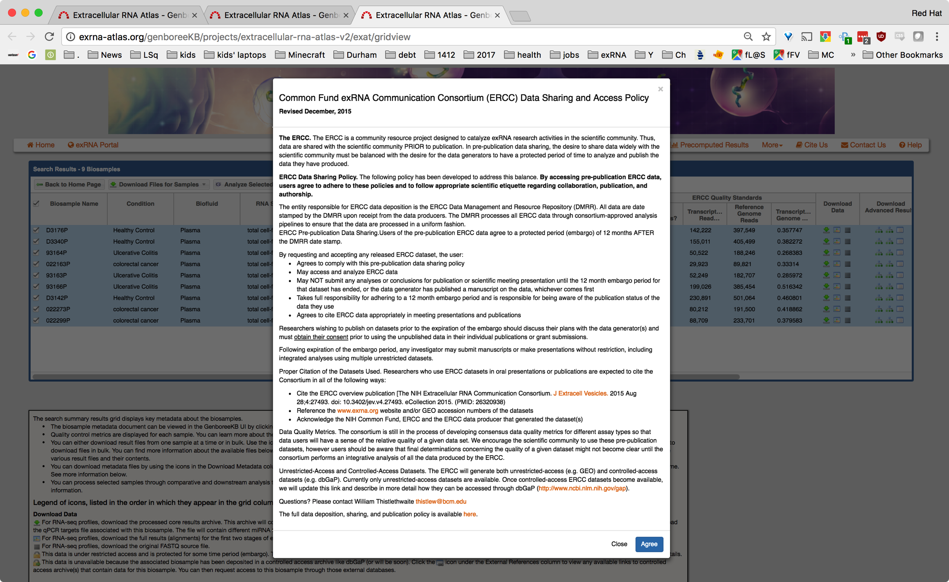
Exogenous phylogenetic trees
2) Agree to the ERCC Data Sharing and Access Policy.

Slide 20
Exogenous phylogenetic trees
The result is an archive file with the name template
<dataset>-<date-processed>_exceRpt_postProcessedResults_<exceRpt-version>.tgz
In this case:
DGALA1-gut-plasma-2016-10-21_exceRpt_postProcessedResults_v4.6.3.tgz
Opening the archive file (the app to use varies with your operating system) generates a large set of files, among which are phylogenetic trees, for all samples in the dataset in aggregate as well as for each sample, visualizing
1) all reads mapped to exogenous genomes
name template: <dataset>-<date-processed>_exceRpt_exogenousGenomes_TaxonomyTrees_
aggregateSamples.pdf
perSample.pdf
2) all reads mapped to exogenous ribosomal RNA
name template: <dataset>-<date-processed>_exceRpt_exogenousRibosomal_TaxonomyTrees_
aggregateSamples.pdf
perSample.pdf
The following slides show DGALA1-gut-plasma-2016-10-21_
exceRpt_exogenousGenomes_TaxonomyTrees_aggregateSamples.pdf

Slide 21
Exogenous phylogenetic trees
Given that many small RNAs in these plasma samples are non-human, what is their source?
The main sources of exogenous small RNA are bacteria (18%) – specifically proteobacteria (7%) – and fungi (7%).
small RNAs mapped to
exogenous genomes

Slide 22
Exogenous phylogenetic trees
Given that many small RNAs in these plasma samples are non-human, what is their source?
The main sources of exogenous small RNA are bacteria (18%) – specifically proteobacteria (7%) – and fungi (7%).
small RNAs mapped to
exogenous genomes

Slide 23
Exogenous phylogenetic trees
Given that many small RNAs in these plasma samples are non-human, what is their source?
The main sources of exogenous small RNA are bacteria (18%) – specifically proteobacteria (7%) – and fungi (7%).
small RNAs mapped to
exogenous genomes

Slide 24
Exogenous phylogenetic trees
Given that many small RNAs in these plasma samples are non-human, what is their source?
The main sources of exogenous small RNA are bacteria (18%) – specifically proteobacteria (7%) – and fungi (7%).
Why do the numbers in the tree images differ from those in the table?

Slide 25
Exogenous phylogenetic trees
The main sources of exogenous small RNA are bacteria (18%) – specifically proteobacteria (7%) – and fungi (7%).
Why do the numbers in the tree images differ from those in the table?
The tree images are built by summing read counts from each specific node with the cumulative number of reads mapped to nodes below it in the tree.
The tables downloaded from the Datasets pull-down are cumulative read counts.
Summing the cumulative and specific read counts from the full exceRpt results generates the same numbers seen in the trees.

Slide 26
Use Case 1: Exogenous exRNA
Which miRNAs are normally present in human plasma?
We can look for the answer to this question by downloading Raw miRNA read counts from the Dataset Files pull-down.
Wang K., Hong L., Yuan Y., Etheridge A., Zhou Y., Huang D., Wilmes P., & Galas D. (2012) The Complex Exogenous RNA Spectra in Human Plasma: An Interface with Human Gut Biota? PLoS ONE 7: e51009.

Slide 27
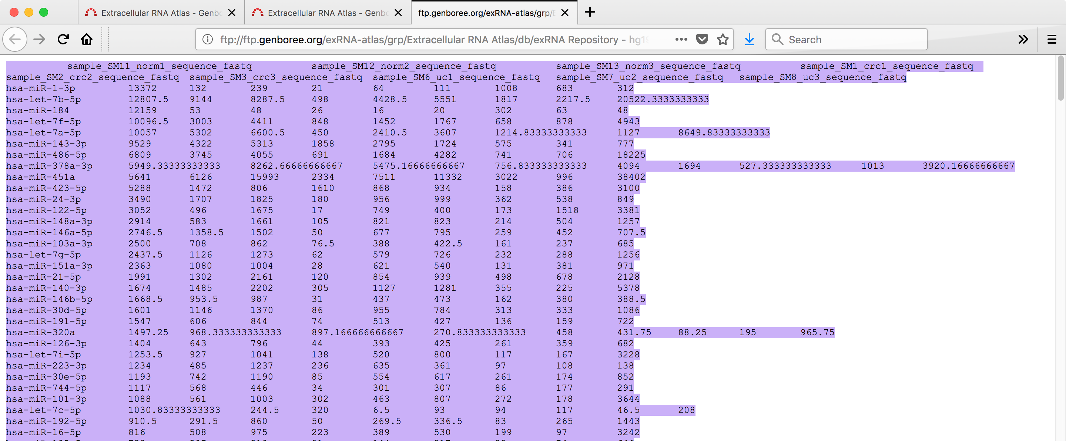
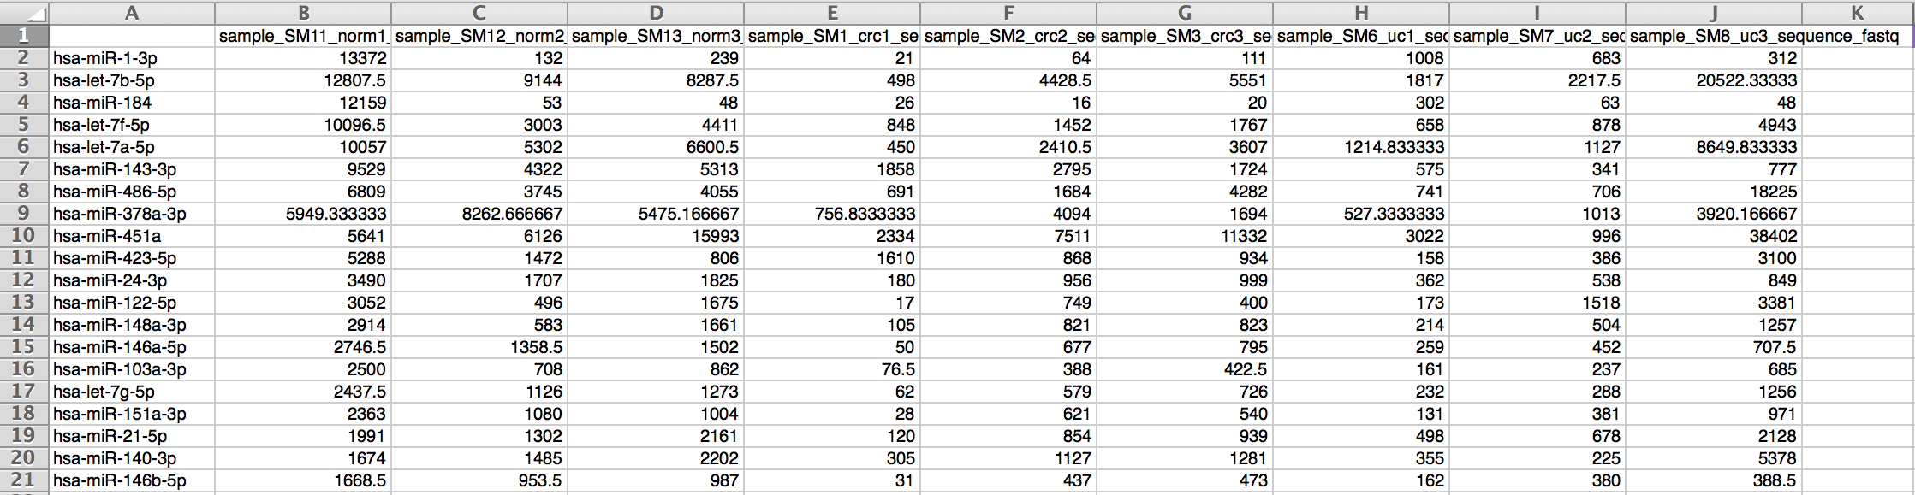
Use Case 1: Exogenous exRNA
Which miRNAs are normally present in human plasma?
Copy and paste that read count table into Excel (Paste Special – as Text).
Then average the read counts for the 3 conditions – healthy controls (norm), colorectal cancer (crc), and ulcerative colitis (uc) – and sort by the average in the normal samples.

Slide 28
Use Case 1: Exogenous exRNA
Which miRNAs are normally present in human plasma?
Back at the exRNA Atlas home page, we can study the pathways in which a group of miRNAs of interest are involved.

Slide 29
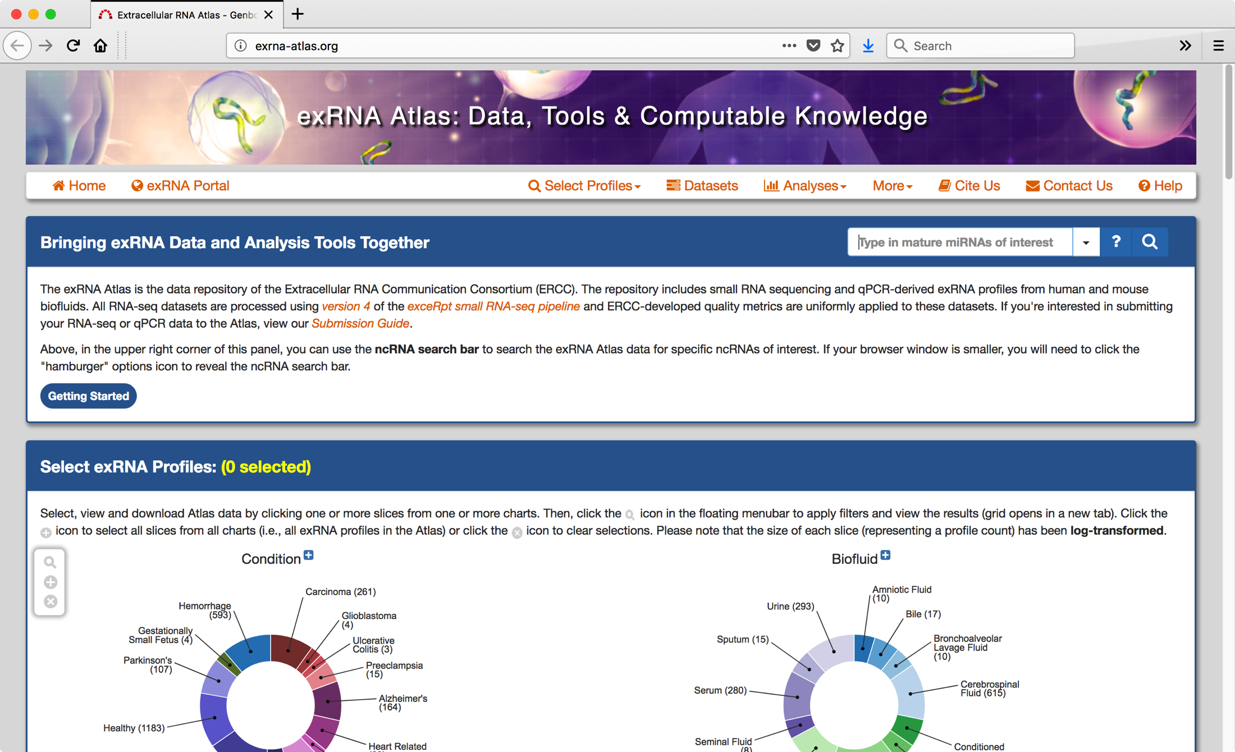
Use Case 1: Exogenous exRNA
Which miRNAs are normally present in human plasma?
Paste the set of complete miRNA identifiers into the ncRNA search box.

Slide 30

Use Case 1: Exogenous exRNA
Which miRNAs are normally present in human plasma?
Paste the set of complete miRNA identifiers into the ncRNA search box.

Slide 31
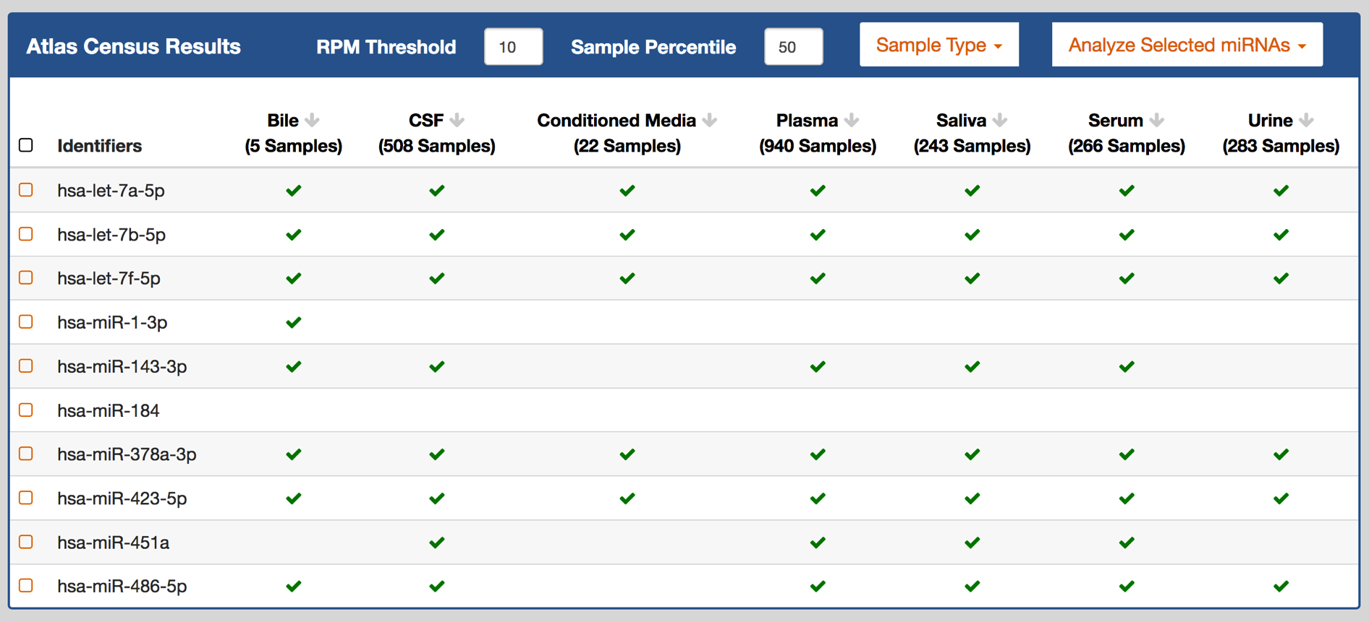
Use Case 1: Exogenous exRNA
Which miRNAs are normally present in human plasma?
The result shows the frequency of the selected ncRNAs in the Atlas' RNA-seq data.

Slide 32

Use Case 1: Exogenous exRNA
Which miRNAs are normally present in human plasma?
The result shows the frequency of the selected ncRNAs in the Atlas' RNA-seq data.
You can focus just on healthy samples.

Slide 33
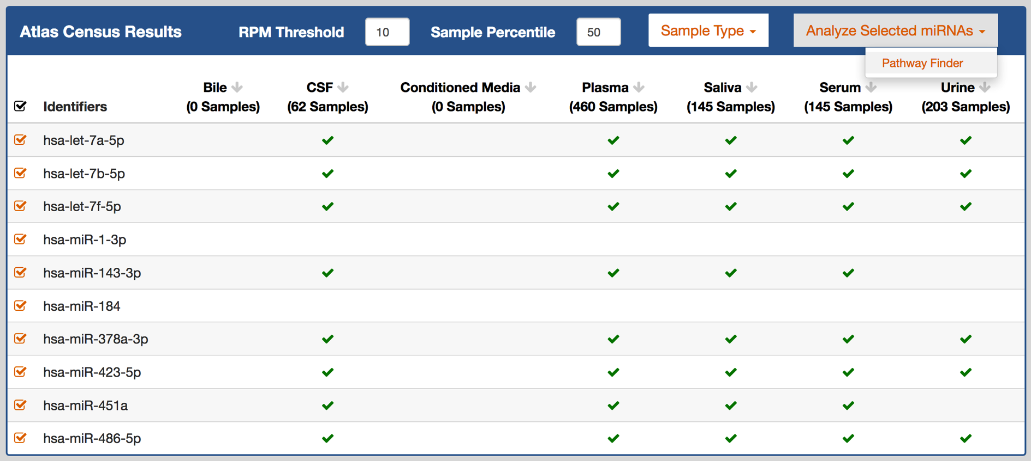
Use Case 1: Exogenous exRNA
Which miRNAs are normally present in human plasma?
The result shows the frequency of the selected ncRNAs in the Atlas' RNA-seq data.
You can focus just on healthy samples...
and use Pathway Finder to to examine which signaling pathways they affect.

Slide 34
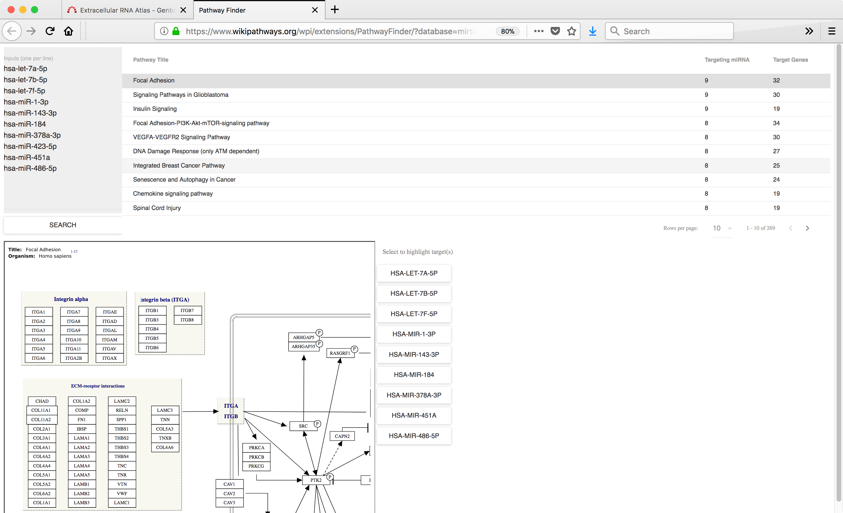
Use Case 1: Exogenous exRNA
Pathway Finder

Slide 35
Use Case 1: Summary
Do all plasma small RNAs map to the human genome?
    No, in this set of plasma samples, more than 50% of small RNAs sequenced map to non-human genomes.
What are the sources of small RNAs found in human plasma that do not map to the human genome?
        In tables and phylogenetic trees, the exceRpt small RNAseq pipeline shows us that the major components of those non-human parasites are fungi and bacteria, specifically proteobacteria.
Which miRNAs are normally present in human plasma?
        We used the Pathway Finder tool just to scratch the surface of analyzing the miRNA content in the sample set.
Wang K., Hong L., Yuan Y., Etheridge A., Zhou Y., Huang D., Wilmes P., & Galas D. (2012) The Complex Exogenous RNA Spectra in Human Plasma: An Interface with Human Gut Biota? PLoS ONE 7: e51009.

