Slide 1

ERCC Data Analysis
Use Case 3:
Biomarker Potential and
Limitations of Circulating miRNA
Performed by the
Data Management and Resource Repository (DMRR)
Williams Z., et al. (2013) Comprehensive profiling of circulating microRNA via small RNA sequencing of cDNA libraries reveals biomarker potential and limitations. PNAS 110: 4255–4260.

Slide 2
Use Case 3: Biomarker Potential and Limitations of Circulating miRNA
The goal of this use case is to show that the Genboree Workbench and the exceRpt small RNA-seq analysis pipeline can replicate the results of Williams et al. We have developed these pipelines because as the Extracellular RNA Communication Consortium (ERCC) begins to generate more datasets, it is vital that they be analyzed in a reproducible and comparable way.
The dataset from Williams et al is freely available in the Short Read Archive (SRA), so it makes a good practice dataset for becoming familiar with the Workbench and exceRpt.
Williams Z., et al. (2013) Comprehensive profiling of circulating microRNA via small RNA sequencing of cDNA libraries reveals biomarker potential and limitations. PNAS 110: 4255–4260.

Slide 3
Use Case 3: Biomarker Potential and Limitations of Circulating miRNA
Biological Question of Interest
This work from the Tuschl lab at Rockefeller University is mainly a technical study. They examined extracellular RNA from the bloodstream of mothers and fathers, their newborn babies, and the placenta. They were interested in quantitating how much exRNA could be found, and whether it would be possible to detect biomarker RNAs at that level. The placenta acted as a model of a tumor; their thinking was that if detecting exRNAs from placenta is feasible, the same should be true of tumors.
Williams Z., et al. (2013) Comprehensive profiling of circulating microRNA via small RNA sequencing of cDNA libraries reveals biomarker potential and limitations. PNAS 110: 4255–4260.

Slide 4
Biological Samples to Be Analyzed
Use Case 3: Biomarker Potential and Limitations of Circulating miRNA
The dataset analyzed in this use case is available from the Short Read Archive (SRA) under Bioproject PRJNA187509.
http://www.ncbi.nlm.nih.gov/bioproject/PRJNA187509

Slide 5
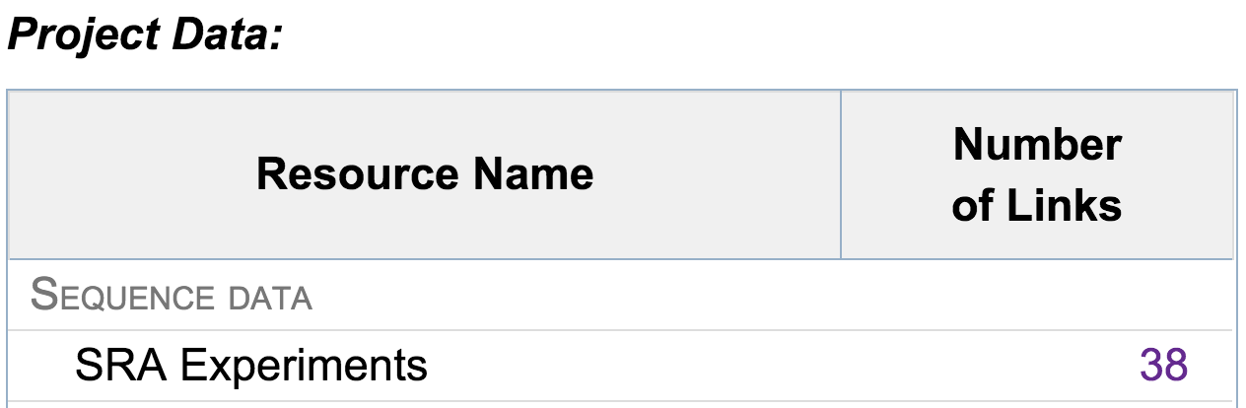
To match the sample names from the article with SRA accessions from the exceRpt output, we visit the Bioproject page at the SRA: http://www.ncbi.nlm.nih.gov/bioproject/PRJNA187509
Use Case 3: Data Scrubbing
Williams Z., et al. (2013) Comprehensive profiling of circulating microRNA via small RNA sequencing of cDNA libraries reveals biomarker potential and limitations. PNAS 110: 4255–4260.

Slide 6
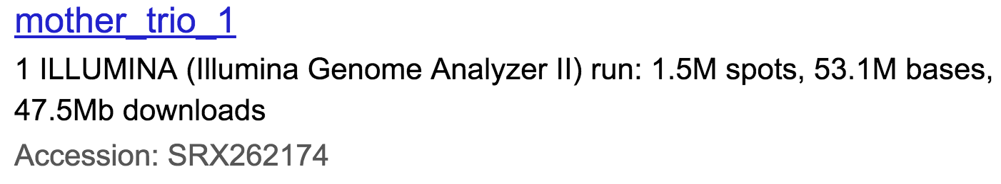
To match the sample names from the article with SRA accessions from the exceRpt output, we visit the Bioproject page at the SRA: http://www.ncbi.nlm.nih.gov/bioproject/PRJNA187509
Use Case 3: Data Scrubbing
Williams Z., et al. (2013) Comprehensive profiling of circulating microRNA via small RNA sequencing of cDNA libraries reveals biomarker potential and limitations. PNAS 110: 4255–4260.

Slide 7
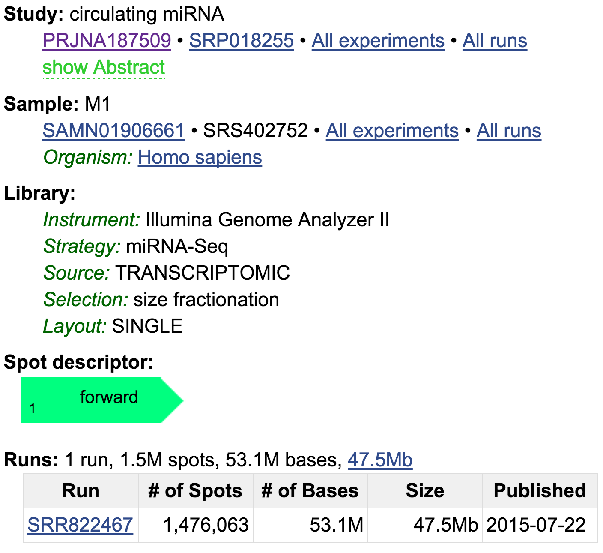
Use Case 3: Data Scrubbing
Williams Z., et al. (2013) Comprehensive profiling of circulating microRNA via small RNA sequencing of cDNA libraries reveals biomarker potential and limitations. PNAS 110: 4255–4260.

Slide 8
After matching sample IDs between the two pipelines, we can import both tables into Excel and start generating comparison plots.
Use Case 3: Data Comparison
Williams Z., et al. (2013) Comprehensive profiling of circulating microRNA via small RNA sequencing of cDNA libraries reveals biomarker potential and limitations. PNAS 110: 4255–4260.

Slide 9
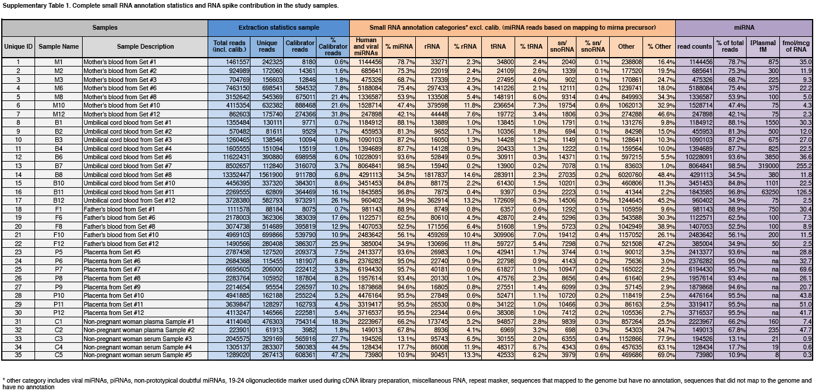
Results from the Article’s analysis pipeline
Use Case 3: Biomarker Potential and Limitations of Circulating miRNA
Williams Z., et al. (2013) Comprehensive profiling of circulating microRNA via small RNA sequencing of cDNA libraries reveals biomarker potential and limitations. PNAS 110: 4255–4260.

Slide 10
We can compare the number of reads mapped to various categories of RNA in Table S1 from the article with the same data from the exceRpt read mapping summary.
Categories in common are total input reads, microRNA, ribosomal RNA, and transfer RNA.
Use Case 3: Biomarker Potential and Limitations of Circulating miRNA
Williams Z., et al. (2013) Comprehensive profiling of circulating microRNA via small RNA sequencing of cDNA libraries reveals biomarker potential and limitations. PNAS 110: 4255–4260.

Slide 11
Use Case 3: exceRpt Pipeline Results -
Number of Input Reads

Slide 12
Use Case 3: exceRpt Pipeline Results –
MicroRNA

Slide 13
Use Case 3: exceRpt Pipeline Results -
Ribosomal RNA

Slide 14
Use Case 3: exceRpt Pipeline Results -
Transfer RNA

Slide 15
The exceRpt analysis pipeline recapitulates the analysis from Williams et al. except for significant differences in the number of reads mapped to transfer RNA.
Use Case 3: Summary
http://genboree.org/theCommons/projects/exrna-tools-may2014/wiki/Version_Updates

Slide 16
We used exceRpt version 2.8.8; the latest version is 3.1.9.
At the Genboree Workbench there is a version history.
Use Case 3: Summary
v2.2.8
We moved the alignment against endogenous repetitive elements (RE) to occur after the main smallRNA alignments performed by sRNABench. This is because we noticed that the RE library was able to ‘compete’ for reads that would be better annotated/interpreted as coming from tRNAs, piRNAs, or other transcripts. This competitive alignment did not ever affect miRNAs as these are always aligned to before other annotated RNAs, but we expect that this update will faithfully capture reads aligning to repetitive small-RNAs, especially tRNAs, piRNAs, and snoRNAs.
exceRpt still aligns to REs as a final step before aligning to exogenous sequences as this is critical to remove highly repetitive endogenous sequences that might otherwise be confused as exogenous sequences.
http://genboree.org/theCommons/projects/exrna-tools-may2014/wiki/Version_Updates

Slide 17

Acknowledgements
Baylor College of Medicine, Houston, TX
Aleksandar Milosavljevic
Matthew Roth
Genboree Team at Baylor
Andrew Jackson
Sai Lakshmi Subramanian
William Thistlethwaite
Sameer Paithankar
Neethu Shah
Aaron Baker
Yale University, New Haven, CT
Mark Gerstein
Joel Rozowsky
Rob Kitchen
Fabio Navarro
Gladstone Institute
Alexander Pico
Anders Riutta
Pacific Northwest Diabetes Research Institute, Seattle, WA
David Galas
Roger Alexander
Rockefeller University, New York, NY
Tom Tuschl
NIH
John Satterlee
Lillian Kuo
Dena Procaccini

Slide 18
Use Case 3: References
Williams Z., et al. (2013) Comprehensive profiling of circulating microRNA via small RNA sequencing of cDNA libraries reveals biomarker potential and limitations. PNAS 110: 4255–4260.
Farazi T.A., et al. (2012) Bioinformatic analysis of barcoded cDNA libraries for small RNA profiling by next-generation sequencing. Methods 58: 171-187.
ExRNA Portal Software Resources
(http://exrna.org/resources/software)

Slide 19
Useful Links
exRNA Portal Software Resources – http://exrna.org/resources/software
exRNA Atlas – http://genboree.org/exRNA-atlas/
Genboree Workbench – http://genboree.org/java-bin/workbench.jsp
Data Coordination Center Wiki –
http://genboree.org/theCommons/projects/exrna-mads/wiki
exRNA Data Analysis Tools Wiki –
http://genboree.org/theCommons/projects/exrna-tools-may2014/wiki
Use Case Tutorials – exRNA Portal Data Resource
http://exrna.org/resources/data/

